Slide 1
Parallel Image/Video Editor
Adam Feinstein and H. Parker Shelton, 520.443, Johns Hopkins University

Slide 2
Project Overview
Adam Feinstein and H. Parker Shelton, 520.443, Johns Hopkins University
GPU-Parallelized Image and Video Editor
Multiple Encoding Algorithms

Slide 3

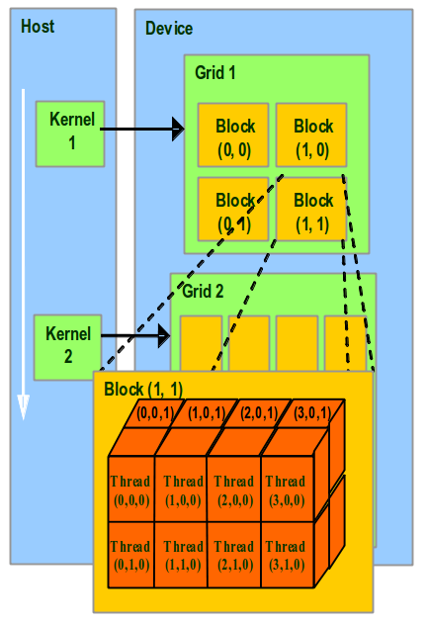
Nvidia’s CUDA
Adam Feinstein and H. Parker Shelton, 520.443, Johns Hopkins University
Compute-Unified Device Architecture
GPU (grid) divided into Blocks, Threads
Each Thread invokes the same kernel, preforms its own calculations

Slide 4
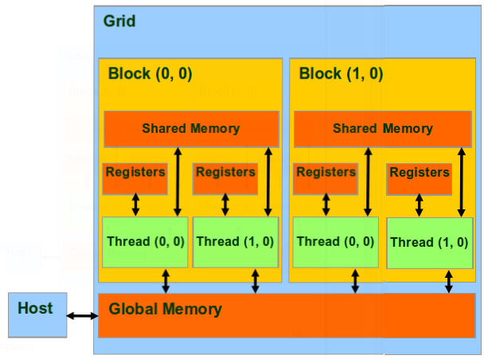
Nvidia’s CUDA
Adam Feinstein and H. Parker Shelton, 520.443, Johns Hopkins University
Threads can share memory, Blocks cannot
Memory must be copied from the host to the GPU and back again

Slide 5

Qt
Adam Feinstein and H. Parker Shelton, 520.443, Johns Hopkins University
Cross-Platform C++ GUI Framework
Multi-threading, Multimedia, WebKit, SQL

Slide 6
GUI Demonstration
Adam Feinstein and H. Parker Shelton, 520.443, Johns Hopkins University

Slide 7
Image Editing
Adam Feinstein and H. Parker Shelton, 520.443, Johns Hopkins University
Grayscale
Brightness
Contrast
Saturation
Crop
Rotate
Scale
Blur
Edge Detect

Slide 8
Grayscale
Adam Feinstein and H. Parker Shelton, 520.443, Johns Hopkins University
// Replace each RGB with the luminance value
for(int y = 0; y < img->height(); y++) {
for(int x = 0; x < img->width(); x++) {
QRgb p = img->pixel(x, y);
r = g = b = (qRed(p) * 0.3) + (qGreen(p) * 0.59) + (qBlue(p) * 0.11);
img->setPixel(x, y, qRgb(r, g, b));
}
}
return img;

Slide 9
GPU: Grayscale
Adam Feinstein and H. Parker Shelton, 520.443, Johns Hopkins University
extern "C" void CUgreyscale(unsigned char* output, unsigned char* input, int row, int col);
void CUgreyscale(unsigned char* output, unsigned char* input, int row, int col)
{
dim3 dimGrid(row/16+1, col/16+1);
dim3 dimThreadBlock(16,16);
greyscale<<<dimGrid, dimThreadBlock>>>(input, output, row, col);
}
__global__ void greyscale(unsigned char* input, unsigned char* output, int row, int col)
{
int xIndex = blockDim.x * blockIdx.x + threadIdx.x;
int yIndex = blockDim.y * blockIdx.y + threadIdx.y;
int index = (4*xIndex + yIndex * row*4);
if(index < row*col*4){
int lum = 0.11*input[index] + 0.59*input[index+1] + 0.3*input[index+2];
output[index]=lum;
output[index+1]=lum;
output[index+2]=lum;
output[index+3]=0;
}
}

Slide 10
Brightness
Adam Feinstein and H. Parker Shelton, 520.443, Johns Hopkins University
// Scale each RGB value by the brightening factor
for(int y = 0; y < img->height(); y++) {
for(int x = 0; x < img->width(); x++) {
QRgb p = img->pixel(x, y);
int r = qRed(p) * factor;
int g = qGreen(p) * factor;
int b = qBlue(p) * factor;
// Clamp color values
img->setPixel(x, y, qRgb(r, g, b));
}
}
return img;

Slide 11
Contrast
Adam Feinstein and H. Parker Shelton, 520.443, Johns Hopkins University
// Scale each RGB value away from the average luminosity
for(int y = 0; y < img->height(); y++) {
for(int x = 0; x < img->width(); x++) {
QRgb p = img->pixel(x, y);
int r = (1-factor)*average_lum + factor*(qRed(p));
int g = (1-factor)*average_lum + factor*(qGreen(p));
int b = (1-factor)*average_lum + factor*(qBlue(p));
// Clamp color values
img->setPixel(x, y, qRgb(r, g, b));
}
}
return img;

Slide 12
Saturation
Adam Feinstein and H. Parker Shelton, 520.443, Johns Hopkins University
// Scale each RGB value away from its luminosity
for(int y = 0; y < img->height(); y++) {
for(int x = 0; x < img->width(); x++) {
QRgb p = img->pixel(x, y);
float lum = (qRed(p) * 0.3) + (qGreen(p) * 0.59) + (qBlue(p) * 0.11);
int r = (1-factor)*lum + factor*(qRed(p));
int g = (1-factor)*lum + factor*(qGreen(p));
int b = (1-factor)*lum + factor*(qBlue(p));
// Clamp color values
img->setPixel(x, y, qRgb(r, g, b));
}
}
return img;

Slide 13
Crop
Adam Feinstein and H. Parker Shelton, 520.443, Johns Hopkins University
// Validate input dimensions and coordinates
// Copy pixels within the coordinates
for(int x = leftX; x < rightX; x++) {
for(int y = leftY; y < rightY; y++)
img->setPixel(x-leftX, y-leftY, img->pixel(x,y));
}
return img;

Slide 14
Rotate
Adam Feinstein and H. Parker Shelton, 520.443, Johns Hopkins University
// Determine new dimensions
// Rotate the image
for(int x = 0; x < newWidth; x++) {
for(int y = 0; y < newHeight; y++) {
float u = cos(-1*a)*(x-newxcenter) - sin(-1*a)*(y-newycenter)+width/2;
float v = sin(-1*a)*(x-newxcenter) + cos(-1*a)*(y-newycenter)+height/2;
// Perform Gaussian sampling to determine pixel color
newImg->setPixel(x, y, Utility::GaussianSample(img, u, v, 0.6, 4));
}
}
return newImg;

Slide 15
Scale
Adam Feinstein and H. Parker Shelton, 520.443, Johns Hopkins University
// Determine new dimensions
// Scale the image
for(int x = 0; x < newWidth; x++) {
for(int y = 0; y < newHeight; y++) {
float u = 1/factor*x;
float v = 1/factor*y;
// Perform sampling to determine pixel color
newImg->setPixel(x, y, Utility::GaussianSample(img, u, v, 0.6, 2*factor));
}
}
return newImg;

Slide 16
Blur
Adam Feinstein and H. Parker Shelton, 520.443, Johns Hopkins University
// Convolution mask
float mask[3][3] = { {1/16.0, 2/16.0, 1/16.0}, {2/16.0, 4/16.0, 2/16.0}, {1/16.0, 2/16.0, 1/16.0} };
for(int y = 0; y < height; y++) {
for(int x = 0; x < width; x++) {
int r = 0, g = 0, b = 0;
for(int i = 0; i <= 2; i++) {
for(int j = 0; j <= 2; j++) {
QRgb pixel = img->pixel(x+(j-1), y+(i-1));
r += mask[i][j]*qRed(pixel);
g += mask[i][j]*qGreen(pixel);
b += mask[i][j]*qBlue(pixel);
}
}
// Clamp color values
}
}
newImg->setPixel(x, y, qRgb(r, g, b));
return newImg;

Slide 17
Edge Detect
Adam Feinstein and H. Parker Shelton, 520.443, Johns Hopkins University
// Convolution mask
float mask[3][3] = { {-1.0, -1.0, -1.0}, {-1.0, 8.0, -1.0}, {-1.0, -1.0, -1.0} };
for(int y = 0; y < height; y++) {
for(int x = 0; x < width; x++) {
int r = 0, g = 0, b = 0;
for(int i = 0; i <= 2; i++) {
for(int j = 0; j <= 2; j++) {
QRgb pixel = img->pixel(x+(j-1), y+(i-1));
r += mask[i][j]*qRed(pixel);
g += mask[i][j]*qGreen(pixel);
b += mask[i][j]*qBlue(pixel);
}
}
// Clamp color values
}
}
newImg->setPixel(x, y, qRgb(r, g, b));
return newImg;

Slide 18
GPU: Edge Detect
Adam Feinstein and H. Parker Shelton, 520.443, Johns Hopkins University
extern "C" void CUedgeDetect(unsigned char* input, unsigned char* output, int row, int col);
void CUedgeDetect(unsigned char* output, unsigned char* input, int row, int col)
{
dim3 dimGrid(row/4+1, col/4+1);
dim3 dimThreadBlock(16,16);
float coeff[9]= {-1, -1, -1, \
-1, 8, -1, \
-1, -1, -1};
float* CUcoeff;
cutilSafeCall(cudaMalloc((void**)&CUcoeff, sizeof(float)*9));
cutilSafeCall(cudaMemcpy(CUcoeff, coeff, sizeof(float)*9, cudaMemcpyHostToDevice));
conv3x3<<<dimGrid, dimThreadBlock>>>(input, output, row, col, CUcoeff);
cutilSafeCall(cudaFree(CUcoeff));
}

Slide 19
GPU: Edge Detect
Adam Feinstein and H. Parker Shelton, 520.443, Johns Hopkins University
__global__ void conv3x3(unsigned char* input, unsigned char* output, int row, int col, float* kernel)
{
int xIndex = blockDim.x * blockIdx.x + threadIdx.x;
int yIndex = blockDim.y * blockIdx.y + threadIdx.y;
int index = (xIndex + yIndex * row*4);
if(index < row*col*4){
int i, j;
float convSum=0;
for(i=-1; i < 2; i++){
for(j=-1; j < 2; j++){
if(-1 < (index+4*j)+(4*col*i) && (index+4*j)+(4*col*i) < row*col*4){
convSum += kernel[3*(i+1) + (j+1)]*input[(index+4*j)+(4*col*i)];
}
}
}
output[index] = CLAMP(convSum);
}
}

Slide 20
CPU vs GPU Speed Comparison
Adam Feinstein and H. Parker Shelton, 520.443, Johns Hopkins University

Slide 21
CPU vs GPU Speed Comparison
Adam Feinstein and H. Parker Shelton, 520.443, Johns Hopkins University

Slide 22
Decoding
Adam Feinstein and H. Parker Shelton, 520.443, Johns Hopkins University
QImage-provided support for .bmp, .gif, .jpg, .png, .pgm, and .tif decoding
Decoding implemented for custom .ppc codec
Image stored in 32-bit RGBA format internally

Slide 23
Encoding
Adam Feinstein and H. Parker Shelton, 520.443, Johns Hopkins University
QImage-provided support for .bmp, .jpg, .png, .tif encoding with quality setting option
Encoding implemented for custom .ppc codec
Huffman Compression
Arithmetic Compression
Run Length Compression

Slide 24
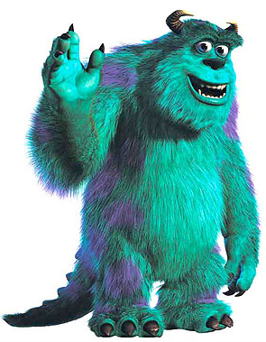
Encoding
Adam Feinstein and H. Parker Shelton, 520.443, Johns Hopkins University
Sully.bmp: 329 Kb
None: 436 Kb
Run Length: 318 Kb
Huffman: 277 Kb
Arithmetic: 874 Kb
Huffman over Run Length: 260 Kb
Arithmetic over Run Length: 636 Kb
Arithmetic over Huffman: 554 Kb
Arithmetic over Huffman over Run Length: 528 Kb

Slide 25
.ppc Codec
void Encoder::write_ppc(QImage* img, QString filename, bool huffman, bool arithmetic, bool runlength) {
int mode = 4*runlength + 2*huffman + arithmetic;
unsigned long numBytes = img->byteCount();
unsigned char* byte_stream = img->bits();
double* arithmetic_stream = NULL;
if(runlength) byte_stream = runlength_encode(byte_stream, &numBytes);
if(huffman) byte_stream = huffman_encode(byte_stream, &numBytes);
if(arithmetic) arithmetic_stream = arithmetic_encode(byte_stream, &numBytes);
FILE* output;
if(!(output = fopen(filename.toStdString().c_str(), "w"))) { return; }
fprintf(output, "%d %d %d %lu", mode, width, height, numBytes);
if(!arithmetic) fwrite(byte_stream, sizeof(unsigned char), numBytes, output);
else fwrite(arithmetic_stream, sizeof(double), numBytes, output);
fclose(output);
}

Slide 26
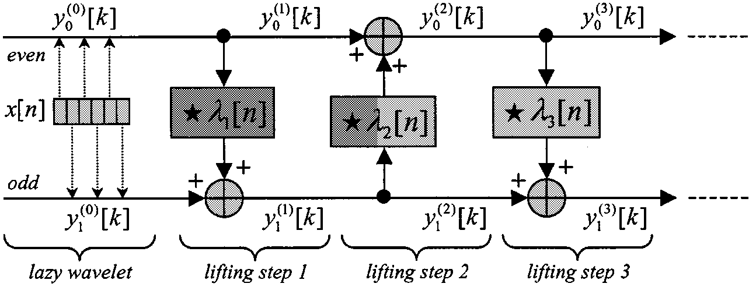
Compression
Adam Feinstein and H. Parker Shelton, 520.443, Johns Hopkins University
Discrete 9/7 Wavelet Transform, lifting implementation
Used Grigory Pau's implementation, uses exact coefficients given by Taubman and Marcellin in JPEG2000 paper
(http://www.embl.de/~gpau/misc/dwt97.c)
CPU: lightly modified, GPU: heavily modified
No color transform, still have to sort out colors
One level transform
Use piecewise continuous function to approximate threshold for zeroing out coefficients give a desired percent of coefficients zeroed out

Slide 27
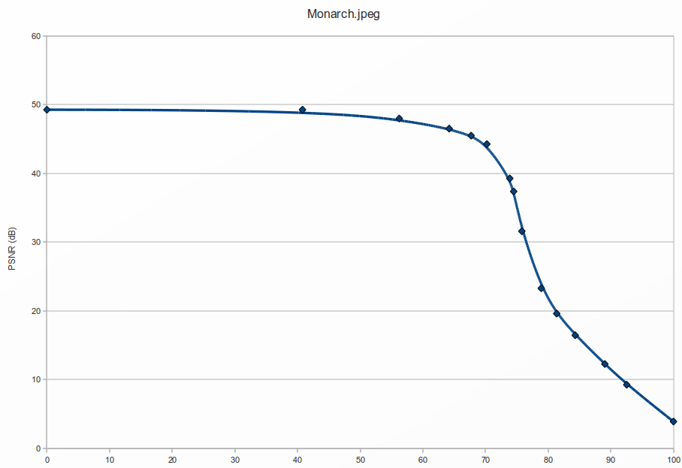
Compression
Adam Feinstein and H. Parker Shelton, 520.443, Johns Hopkins University

Slide 28
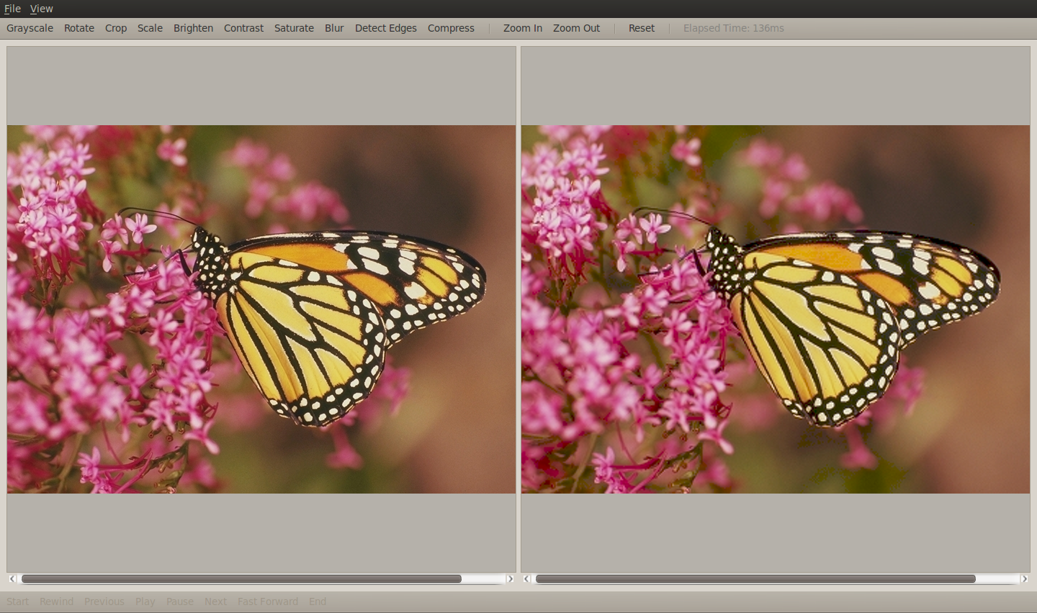
Compression
Adam Feinstein and H. Parker Shelton, 520.443, Johns Hopkins University

Slide 29
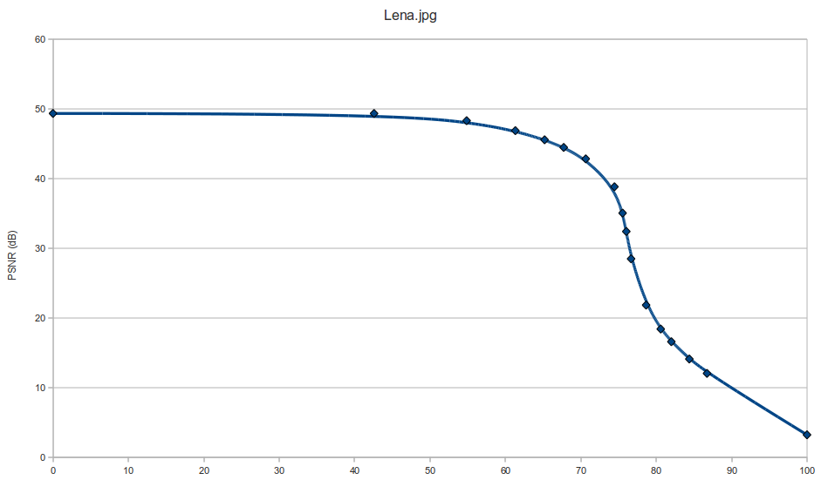
Compression
Adam Feinstein and H. Parker Shelton, 520.443, Johns Hopkins University

Slide 30
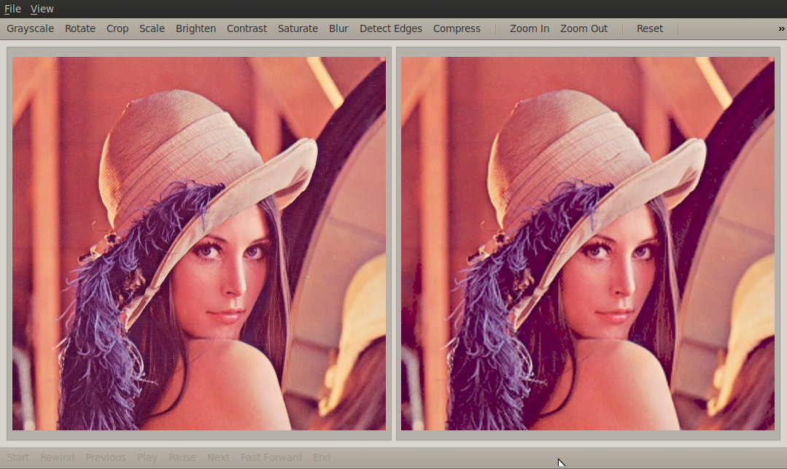
Compression
Adam Feinstein and H. Parker Shelton, 520.443, Johns Hopkins University

Slide 31
CPU vs GPU Speed Comparison
Adam Feinstein and H. Parker Shelton, 520.443, Johns Hopkins University

Slide 32
CPU vs GPU Speed Comparison
Adam Feinstein and H. Parker Shelton, 520.443, Johns Hopkins University
GPU Limitations:
cudaMemcpy() still runs in linear time, necessary to move data onto and off of a GPU
Resources used by operating system, failed to allocate space for a 4096x4096 image (64MB * 2)
Wavelet transform doesn't use __shared__ memory

Slide 33
Questions?

